Slide 1
CUSTOMER SATISFACTION(CSAT) ANALYTICS POWER BI | SQL
Prepared by:
M LOKESH NAIK
PTID-CDA-JUN-26-11205-F
CDA(2nd march batch)
mlokeshnaik1996@gmail.com

Slide 2
Project Objective:
To analyse Customer Satisfaction (CSAT) data and evaluate customer experience, service quality, and agent performance using SQL and Power BI. The project aims to identify key trends and generate actionable insights to support data-driven business decisions and improve customer satisfaction.
Goal:
To provide data-driven insights that help improve customer satisfaction by identifying service trends, evaluating agent performance, and monitoring key CSAT metrics. The analysis supports better decision-making to enhance customer experience and operational efficiency.

Slide 3
Business Problem
The company receives customer interactions through multiple channels such as Call Center, Email, Chatbot and Web.
Management wants to understand:
• Customer satisfaction levels
• Customer sentiment patterns
• Survey participation rates
• Impact of response time
• State and channel performance
Customer Interaction
↓
Customer Survey
↓
CSAT Analysis
↓
Business Insights

Slide 4
Dataset Overview
Contents:
Total Records = 32940
Rated customers = 12270
Unrated customers = 20670
Channels = 4
States = 50
Sentiments = 5
Columns:
CSAT Score
Sentiment
State
Channel
Reason
Response Time
Call Duration
Call Center

Slide 5
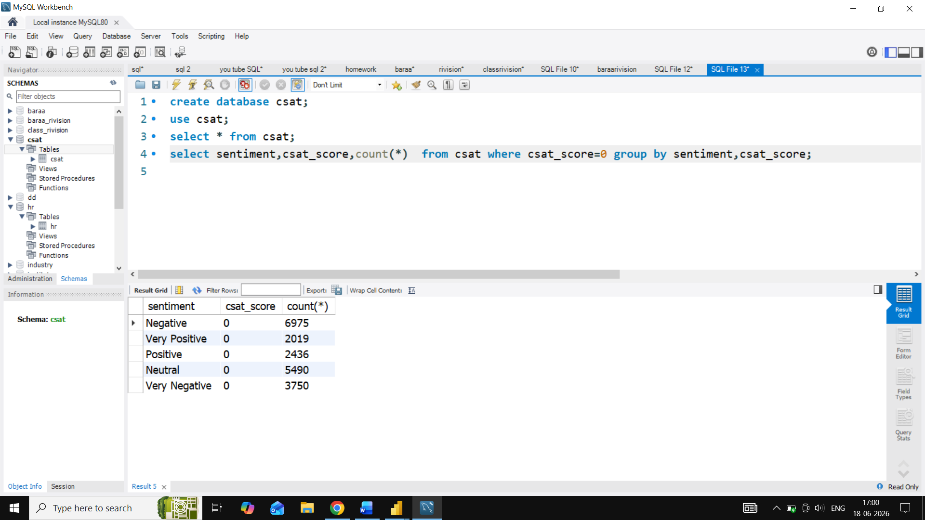
Data Cleaning Process
What I did:
Removed duplicate records.
Verified missing values.
Identified CSAT Score=0 has Non-responsive.
Changed datatype of column.
Created DAX measures.
Created new column.
Raw Data
↓
Cleaning & Queries
↓
Validation
↓
Power BI Model

Slide 6
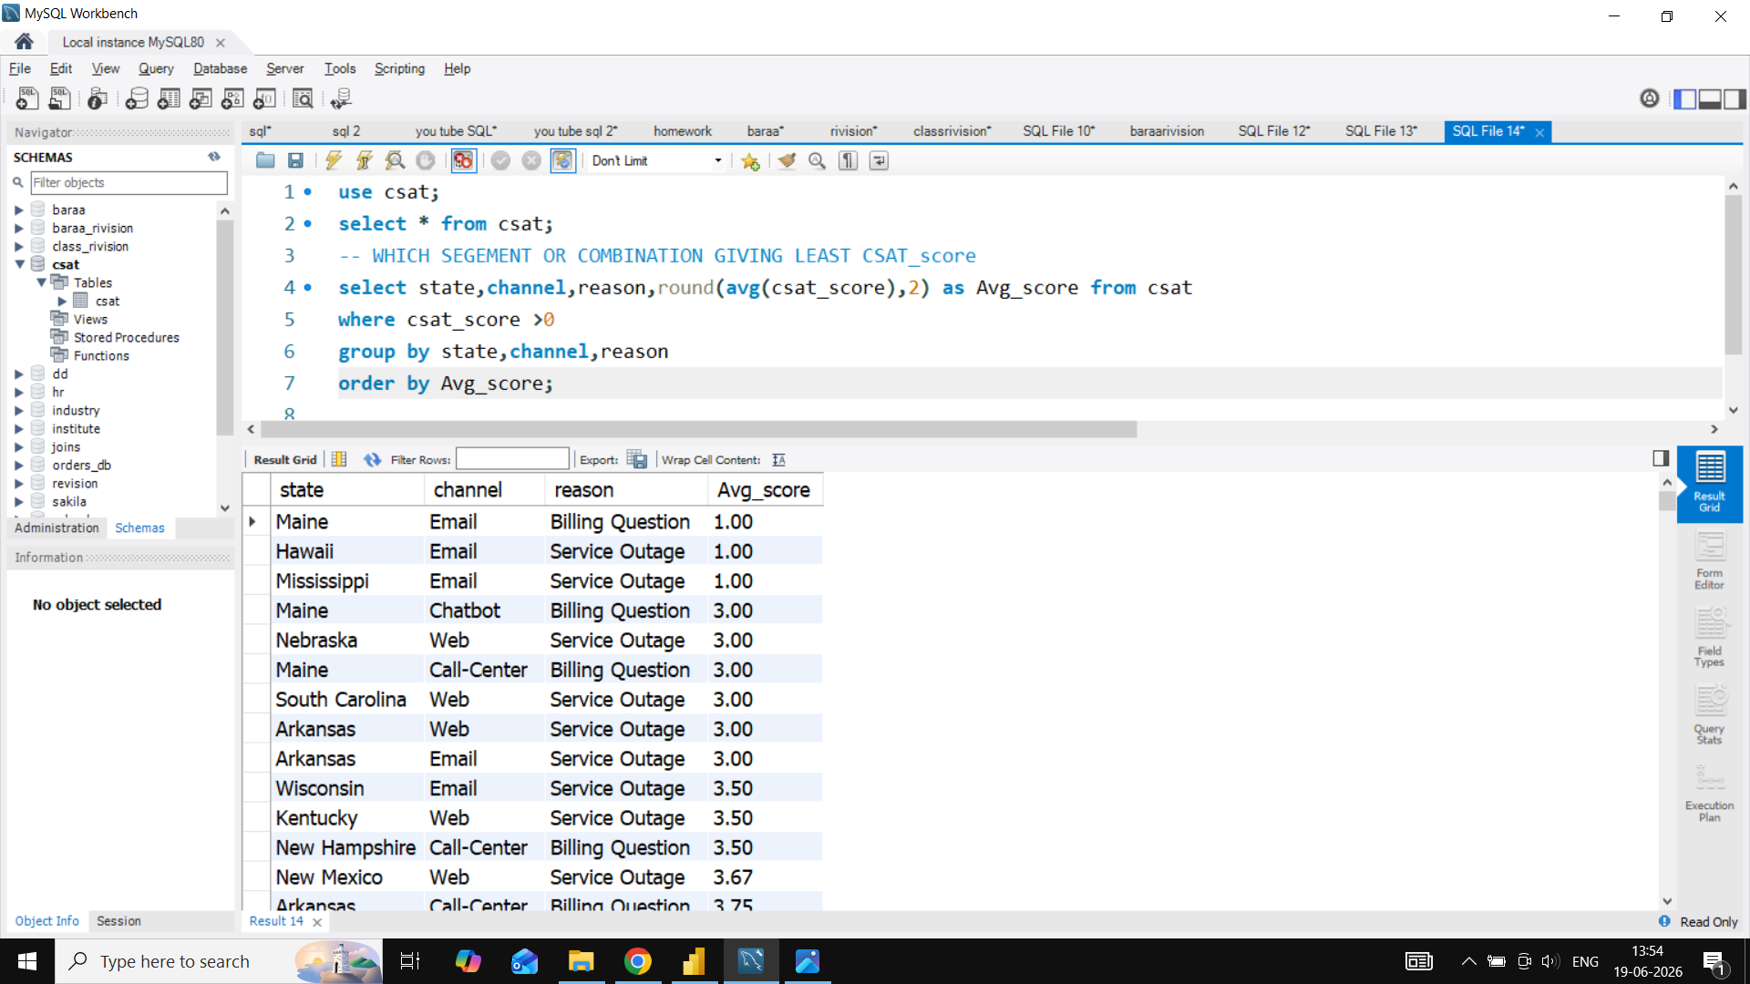
SQL Analysis
Survey participation rate.
State wise CSAT analysis.
Reason and Sentiment analysis.
State ,channel and Reason on CSAT score analysis .
Customer Sentiment analysis.
State response rate analysis.
Call Centre Performance Analysis.

Slide 7
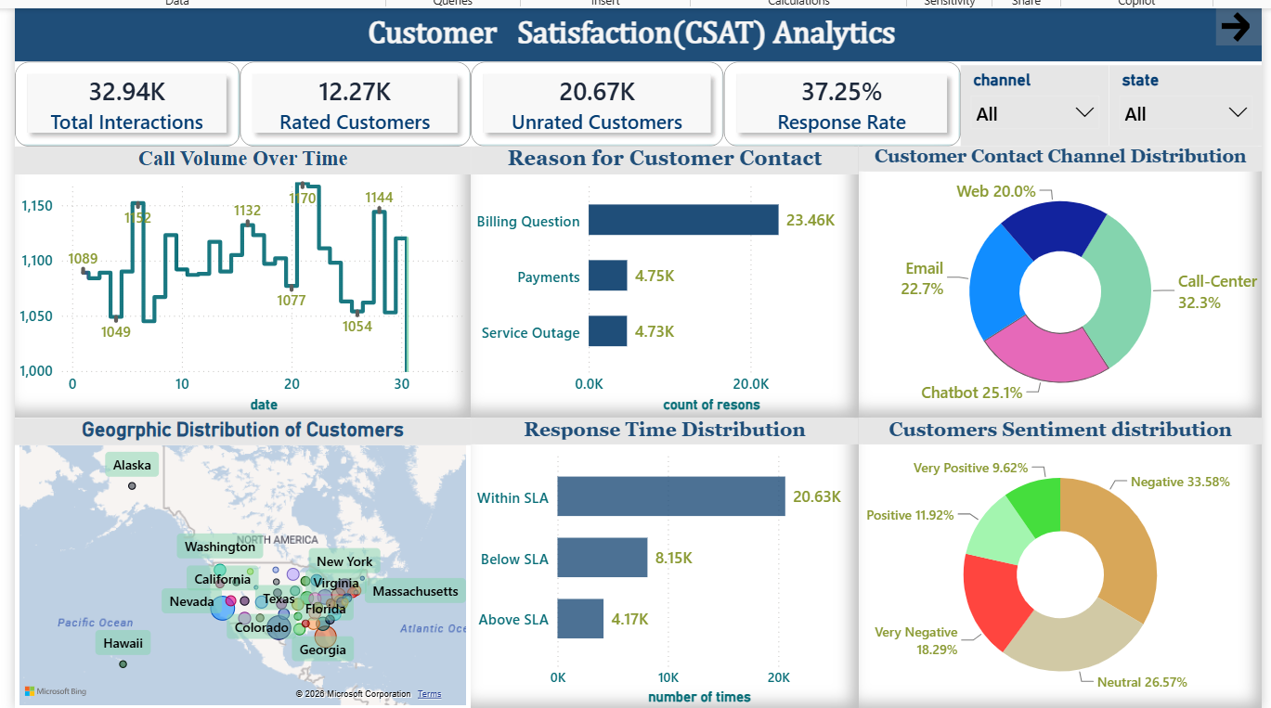
Dashboard 1- Customers Interaction Analysis

Slide 8
Dashboard 1 Insights:
Total Interactions = 32.94k
Rated Customers =12.27k
Unrated Customers =20.67k
Only 37.25% customers submitted surveys.
Billing Questions generate the highest contact volume.
Call Center is the most preferred channel.
Majority of interactions are handled within SLA.
Majority of customer interactions fall within Neutral and Negative sentiment categories.

Slide 9
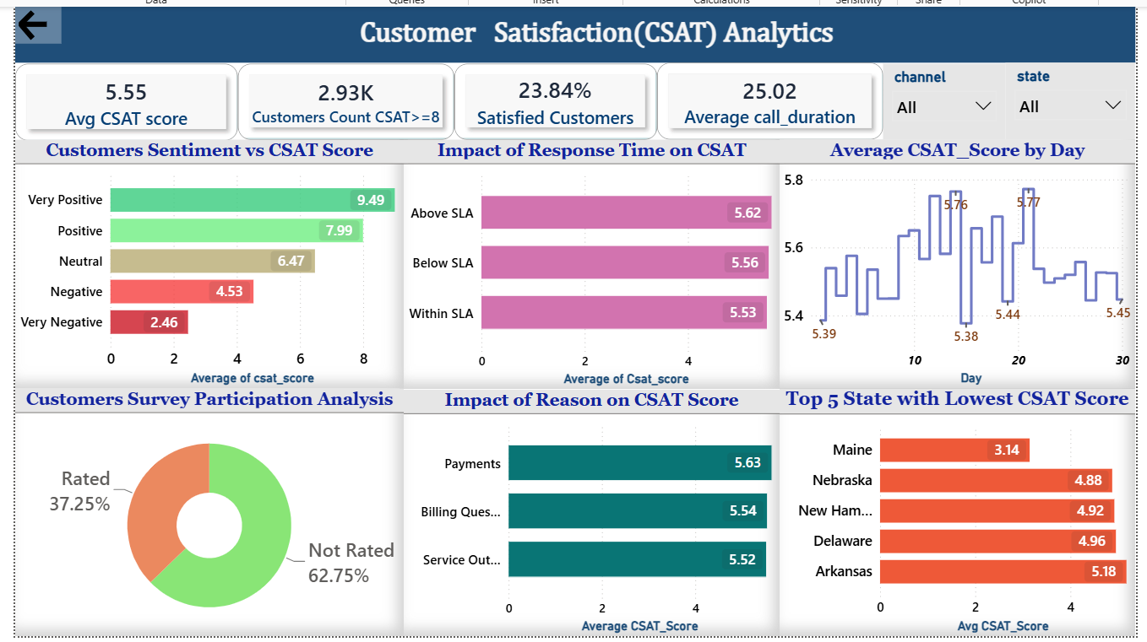
Dashboard 2 – Customers Satisfaction Analysis

Slide 10
Dashboard 2 Insights:
Average CSAT Score = 5.55
Satisfied Customers = 23.84%
Very Positive customers average 9.49 CSAT Score vs 2.46 for Very Negative customers.
Call Center channel has the highest average satisfaction.
Customer sentiment shows a strong positive correlation with CSAT scores
Maine records the lowest CSAT score.
Response time has limited impact on CSAT compared to issue resolution quality.

Slide 11
Recommendation:
Increase survey participation through follow-up reminders.
Investigate root causes of Billing Question contacts.
Focus service improvement initiatives on low-CSAT states.
Monitor sentiment trends proactively.
Regularly monitor channel-wise CSAT performance to identify underperforming service channels and optimize customer support operations.
Improve first-contact resolution and issue resolution quality to increase customer satisfaction.
Improve proactive communication during service outages to reduce the 33.58% negative sentiment.
Automate routine queries (e.g., password resets) with chatbots to cut down the 25-minute average call duration.

Slide 12
Skills Demonstrated:
Data Cleaning & Validation.
SQL Querying & Business Analysis .
Power BI Dashboard Development.
DAX Measures & KPIs.
Generated actionable business Insights and Recommendations.

Slide 13
Conclusion:
The project successfully identified customer satisfaction drivers, survey participation patterns, and service performance opportunities.
The dashboard enables management to monitor customer experience and make data-driven decisions.
Thank You…

